Slide 1
Automated Hyperspectral Pyrometry of Bulk Crystal Growths
Naman Parikh¹, Tyrel McQueen^{3,4,5,6}, David Elbert^{2,3}
¹Carnegie Mellon University, ²Institute for Data Intensive Engineering and Sciences, ³Hopkins Extreme Materials Institute, ⁴JHU Department of Materials Science and Engineering, ⁵JHU Department of Chemistry, ⁶Institute for Quantum Matter

Slide 2
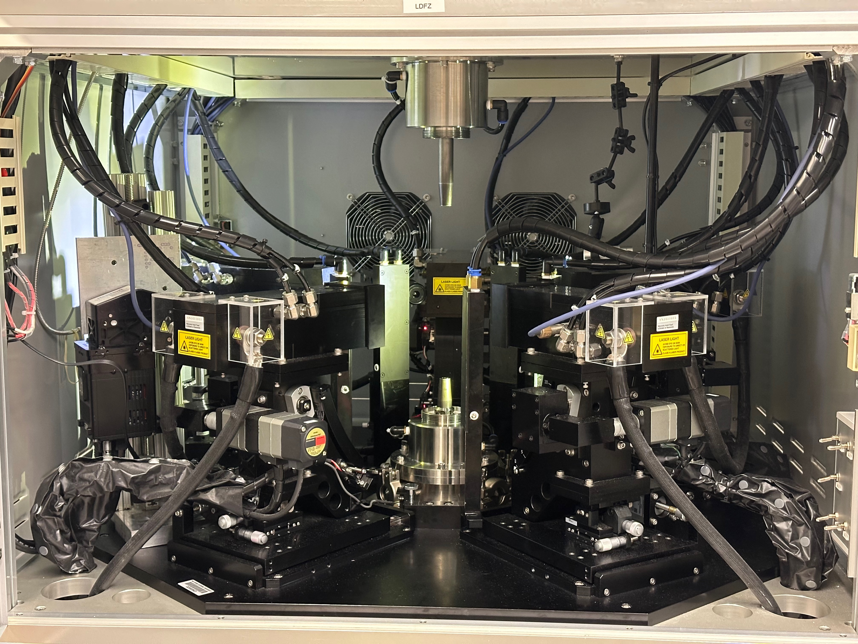
Laser Diode Floating Zone
Replace with picture that includes someone
Notes:
My work was with floating zone growths, and specifically we worked out of the LDFZ

Slide 3
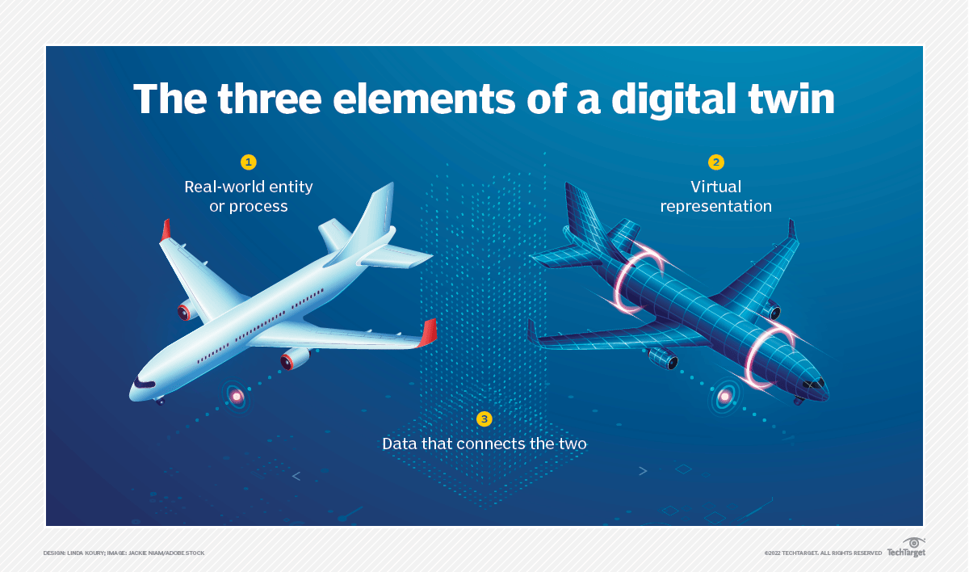
Digital Twins
Notes:
A digital twin is basically a digital representation of some physical object or process. It’s an extension or generalization of things like simulations which represent physical processes or objects which represent real with properties and changes. The twin is a virtual representation of the real thing, but there is an important third piece, which is data. Whenever you try to make a digital twin, you fundamentally need some data to inform how the twin should work and to verify that the twin is operating accurately and producing the results it should. My work is about finding this data to connect the floating zone growth process to it’s twin.

Slide 4
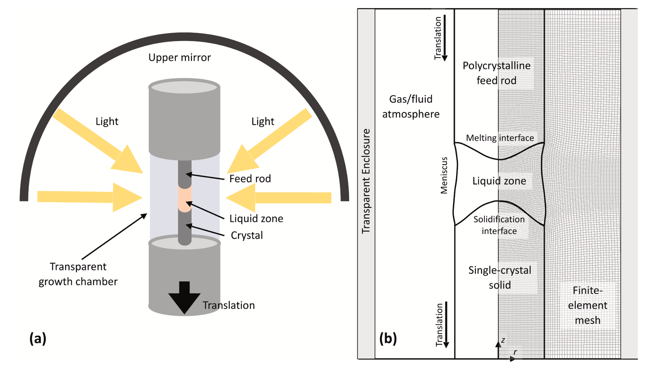
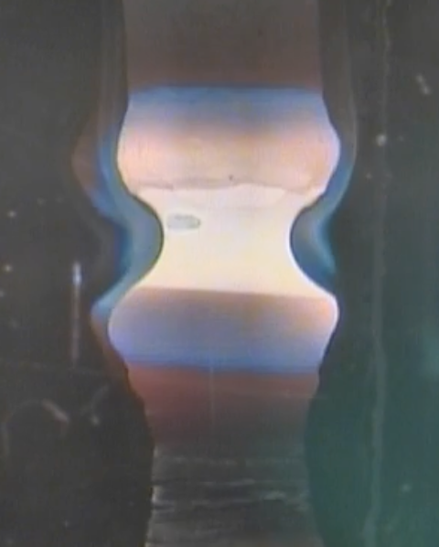
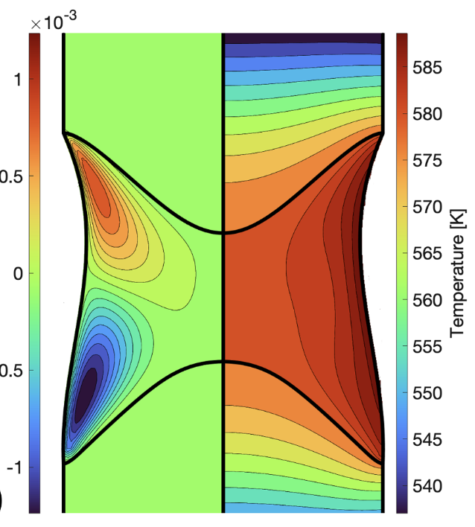
Physical
Digital
This with control panel to talk about the controls and how they affect the growth
Data
?
Scott S. Dossa, Jeffrey J. Derby
https://doi.org/10.1016/j.jcrysgro.2022.126723
Notes:
So, what are these 3 elements for floating zone growths? The physical aspect would be the growth itself, the process of the growth and the underlying physics that governs the growth. Also an important part of the physical element is the controls of the furnace. The experimenter can change things like the rotation speed and pull rate, and these affect the growth. The last physical element is the crystal the is made at the end. Whether it’s a single or multiple crystal, it’s structure, and it’s properties. The digital twin that is being made in other work is computational models and simulations of the growths. This includes finite element models to track the thermal distribution and fluid flow during a growth. Currently, these models have had some success in different ways of simulating the molten zone and solid-liquid interface, but they are informed only by physics theory and not actual growth data, and they are not validated against physical growths. So, they are fundamentally disconnected because of the lack of data.

Slide 5
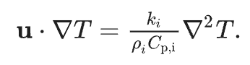
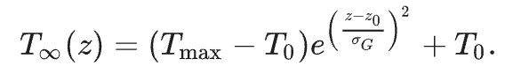
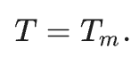
Modeling – NaNO₃
Scott S. Dossa, Jeffrey J. Derby
https://doi.org/10.1016/j.jcrysgro.2022.126723
5
Notes:
What makes these models difficult to use because the inputs for the models are not the same as the inputs for a physical growth. For a physical growth, we have things like the laser power and pull rate, but the input for the models is things like the temperature field, which we don’t know how to measure for a physical growth. IF I WANT TO USE THE MODEL TO INFORM MY GROWTH, I need some way to measure the temperature distribution so I can then input it into the model. Additionally, the model doesn’t know how to determine how the heat will flow as the samples are heated up during the growth. Temperature is missing as data for the physical growths and because of this is missing from the model’s ability to predict. So, data that would be useful in developing a digital twin is the temperature distributions of growths.

Slide 6
Research Question
How can we collect temperature data from lab growths?

Slide 7
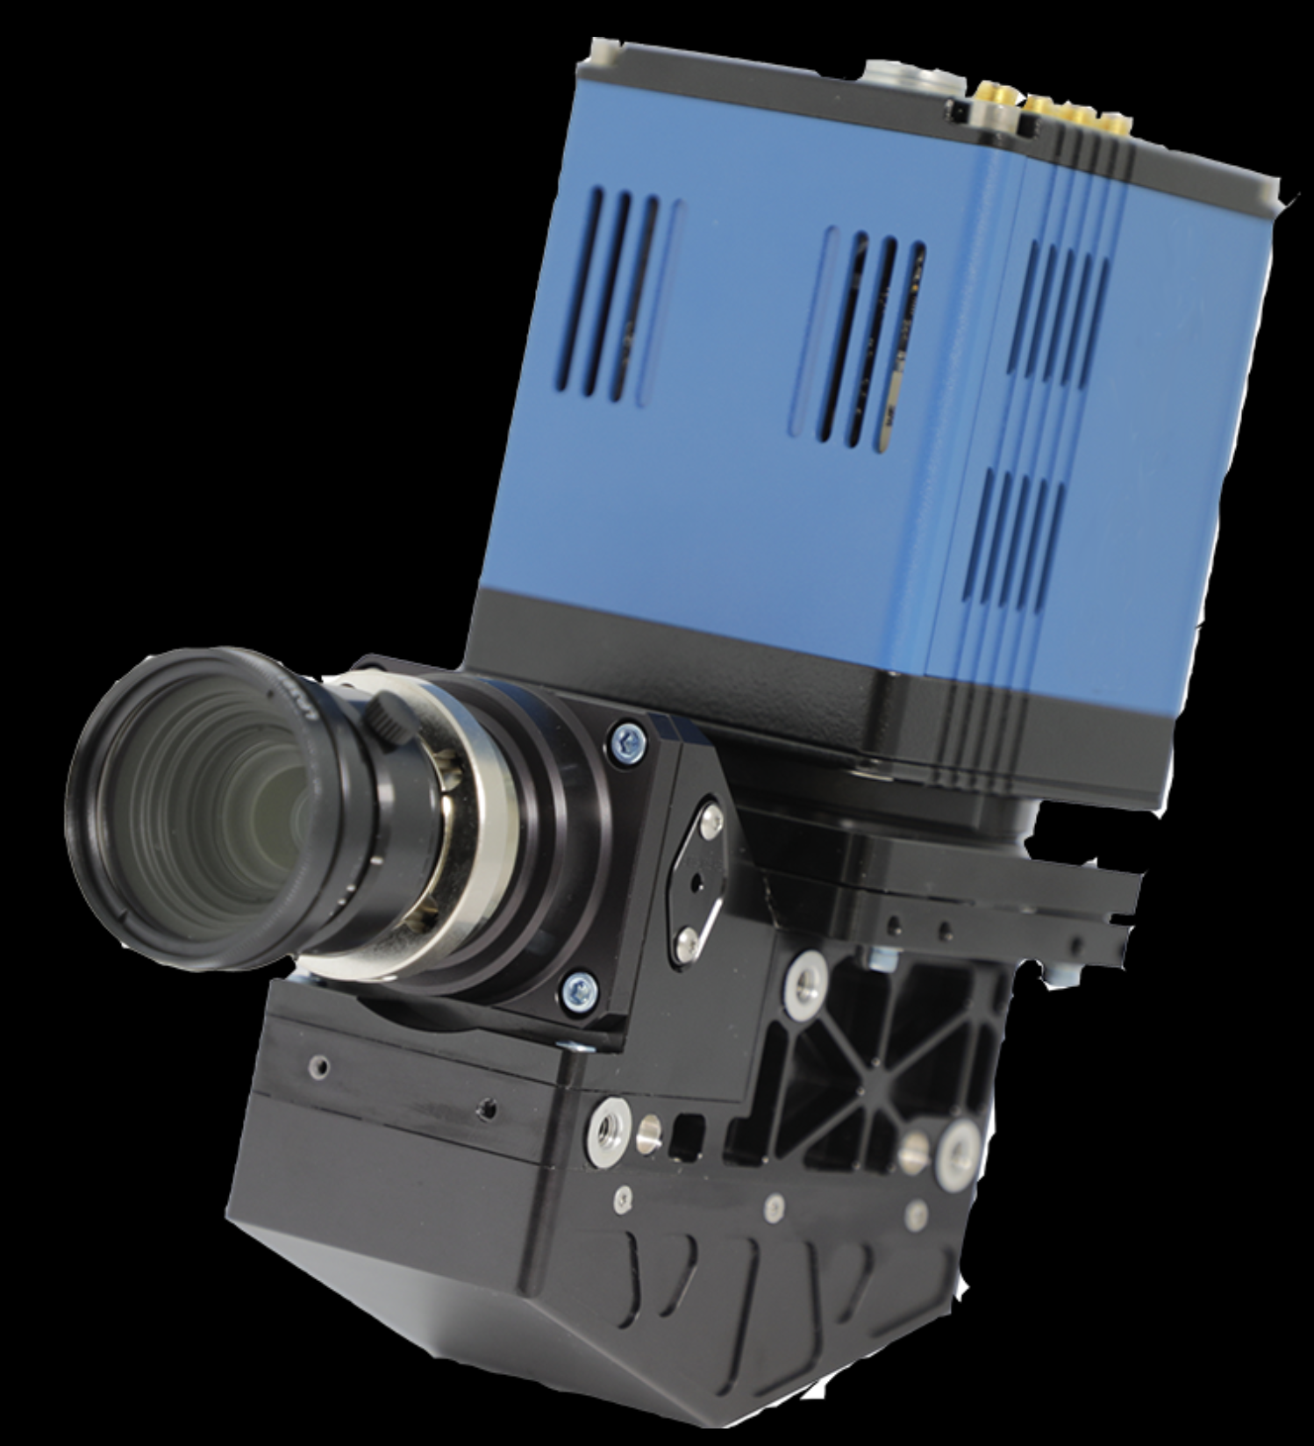
Hyperspectral Camera
Notes:
This is a hyperspectral camera. Ours is unfortunately not blue but that’s ok. It is a camera that measures hyperspectral data, which means intensity values at hundreds of wavelengths. This allows us to image an entire spectrum for each pixel.

Slide 8
What are the steps?
Collect data
Notes:
Obviously

Slide 9
Notes:
So to collect data, one of the things we did was set up the camera in the furnace.

Slide 10
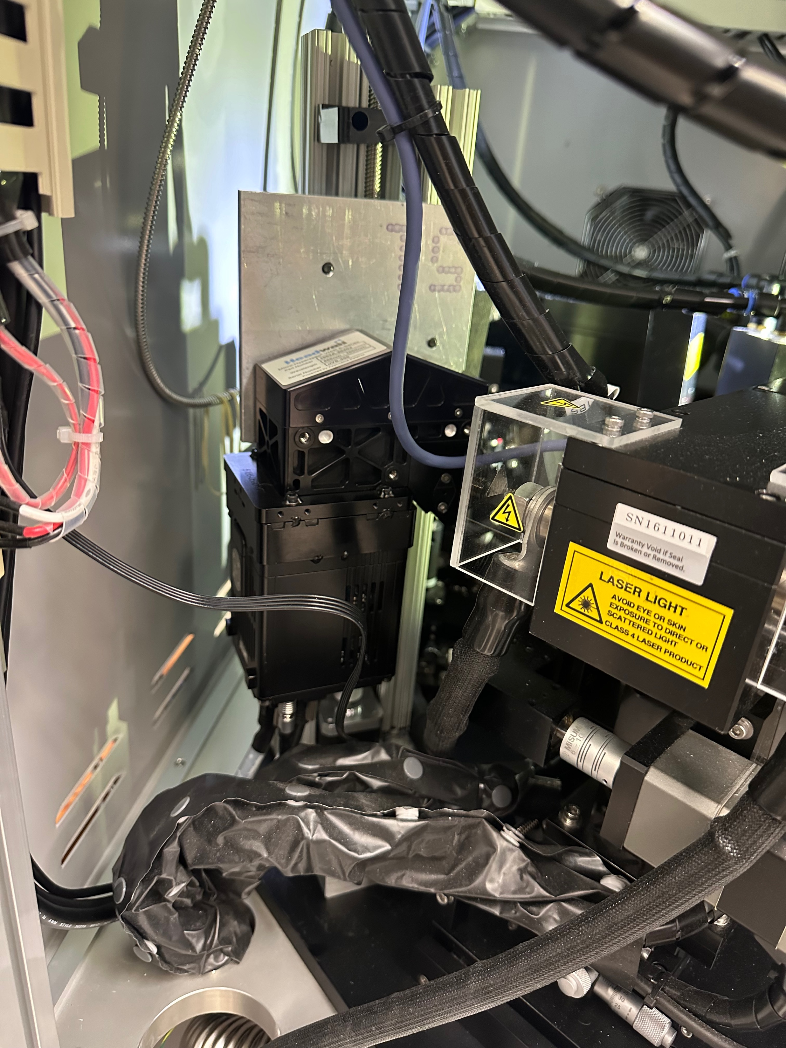

Slide 11
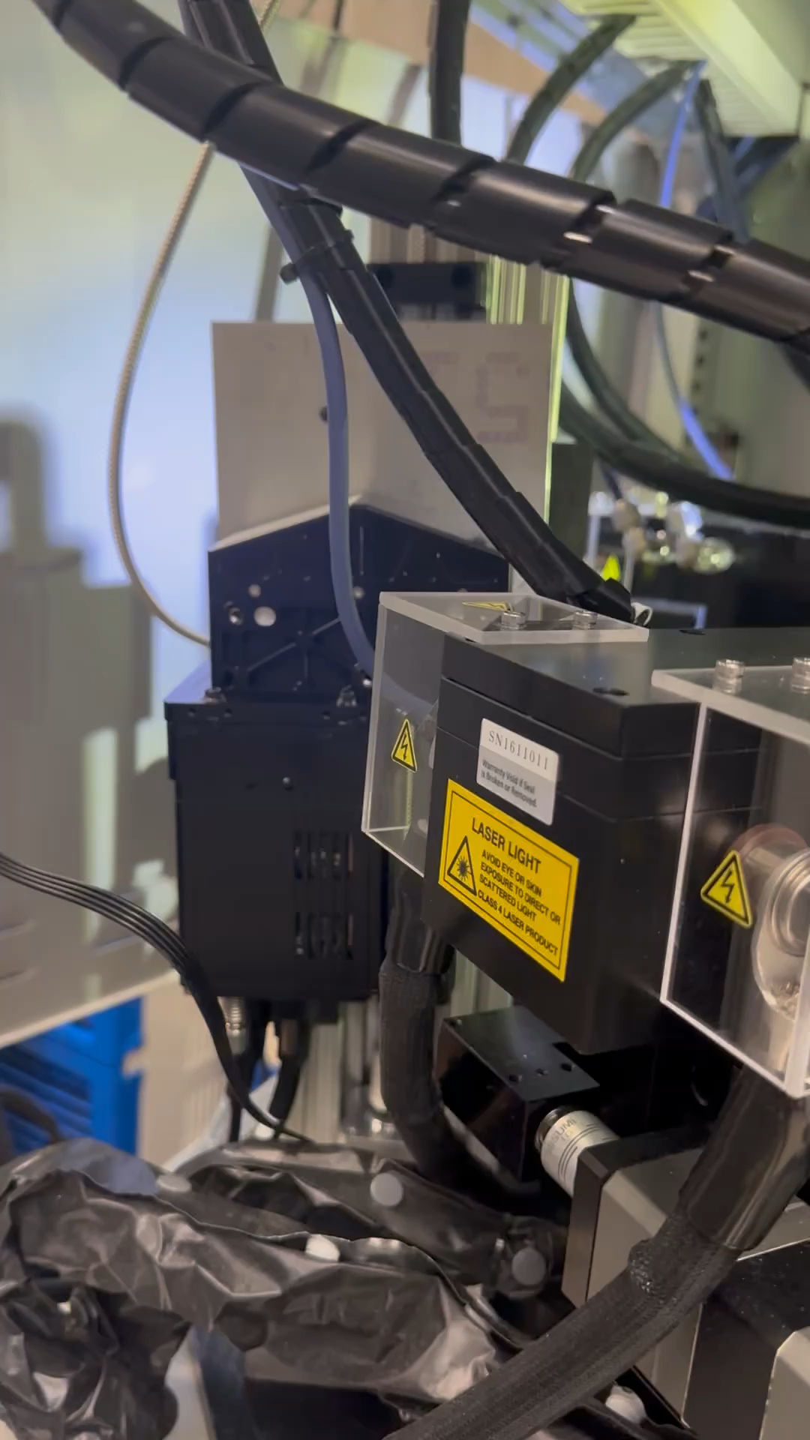
Notes:
One detail about the hyperspectral camera is that it only captures a line rather than a 2-D image. Because of this, we need to scan the camera up and down to capture an entire image.

Slide 12
What are the steps?
Collect data
Analyze the data
Notes:
We need some way to determine the temperature from the hyperspectral data, which will take some physics and machine learning to do

Slide 13
What are the steps?
Collect data
Analyze the data automatically
Notes:
We want to ultimately collect a lot of data and collect it regularly, so we would like to automate this process to make it faster and easier. If we had robots that automatically took a sample out of the furnace, put it through an XRD analysis, and spit out the ready-to-analyze results, things would be much faster. This is the same idea; we have the computers automatically grab images as they come, analyze them, and spit out the result that we want to look at

Slide 14
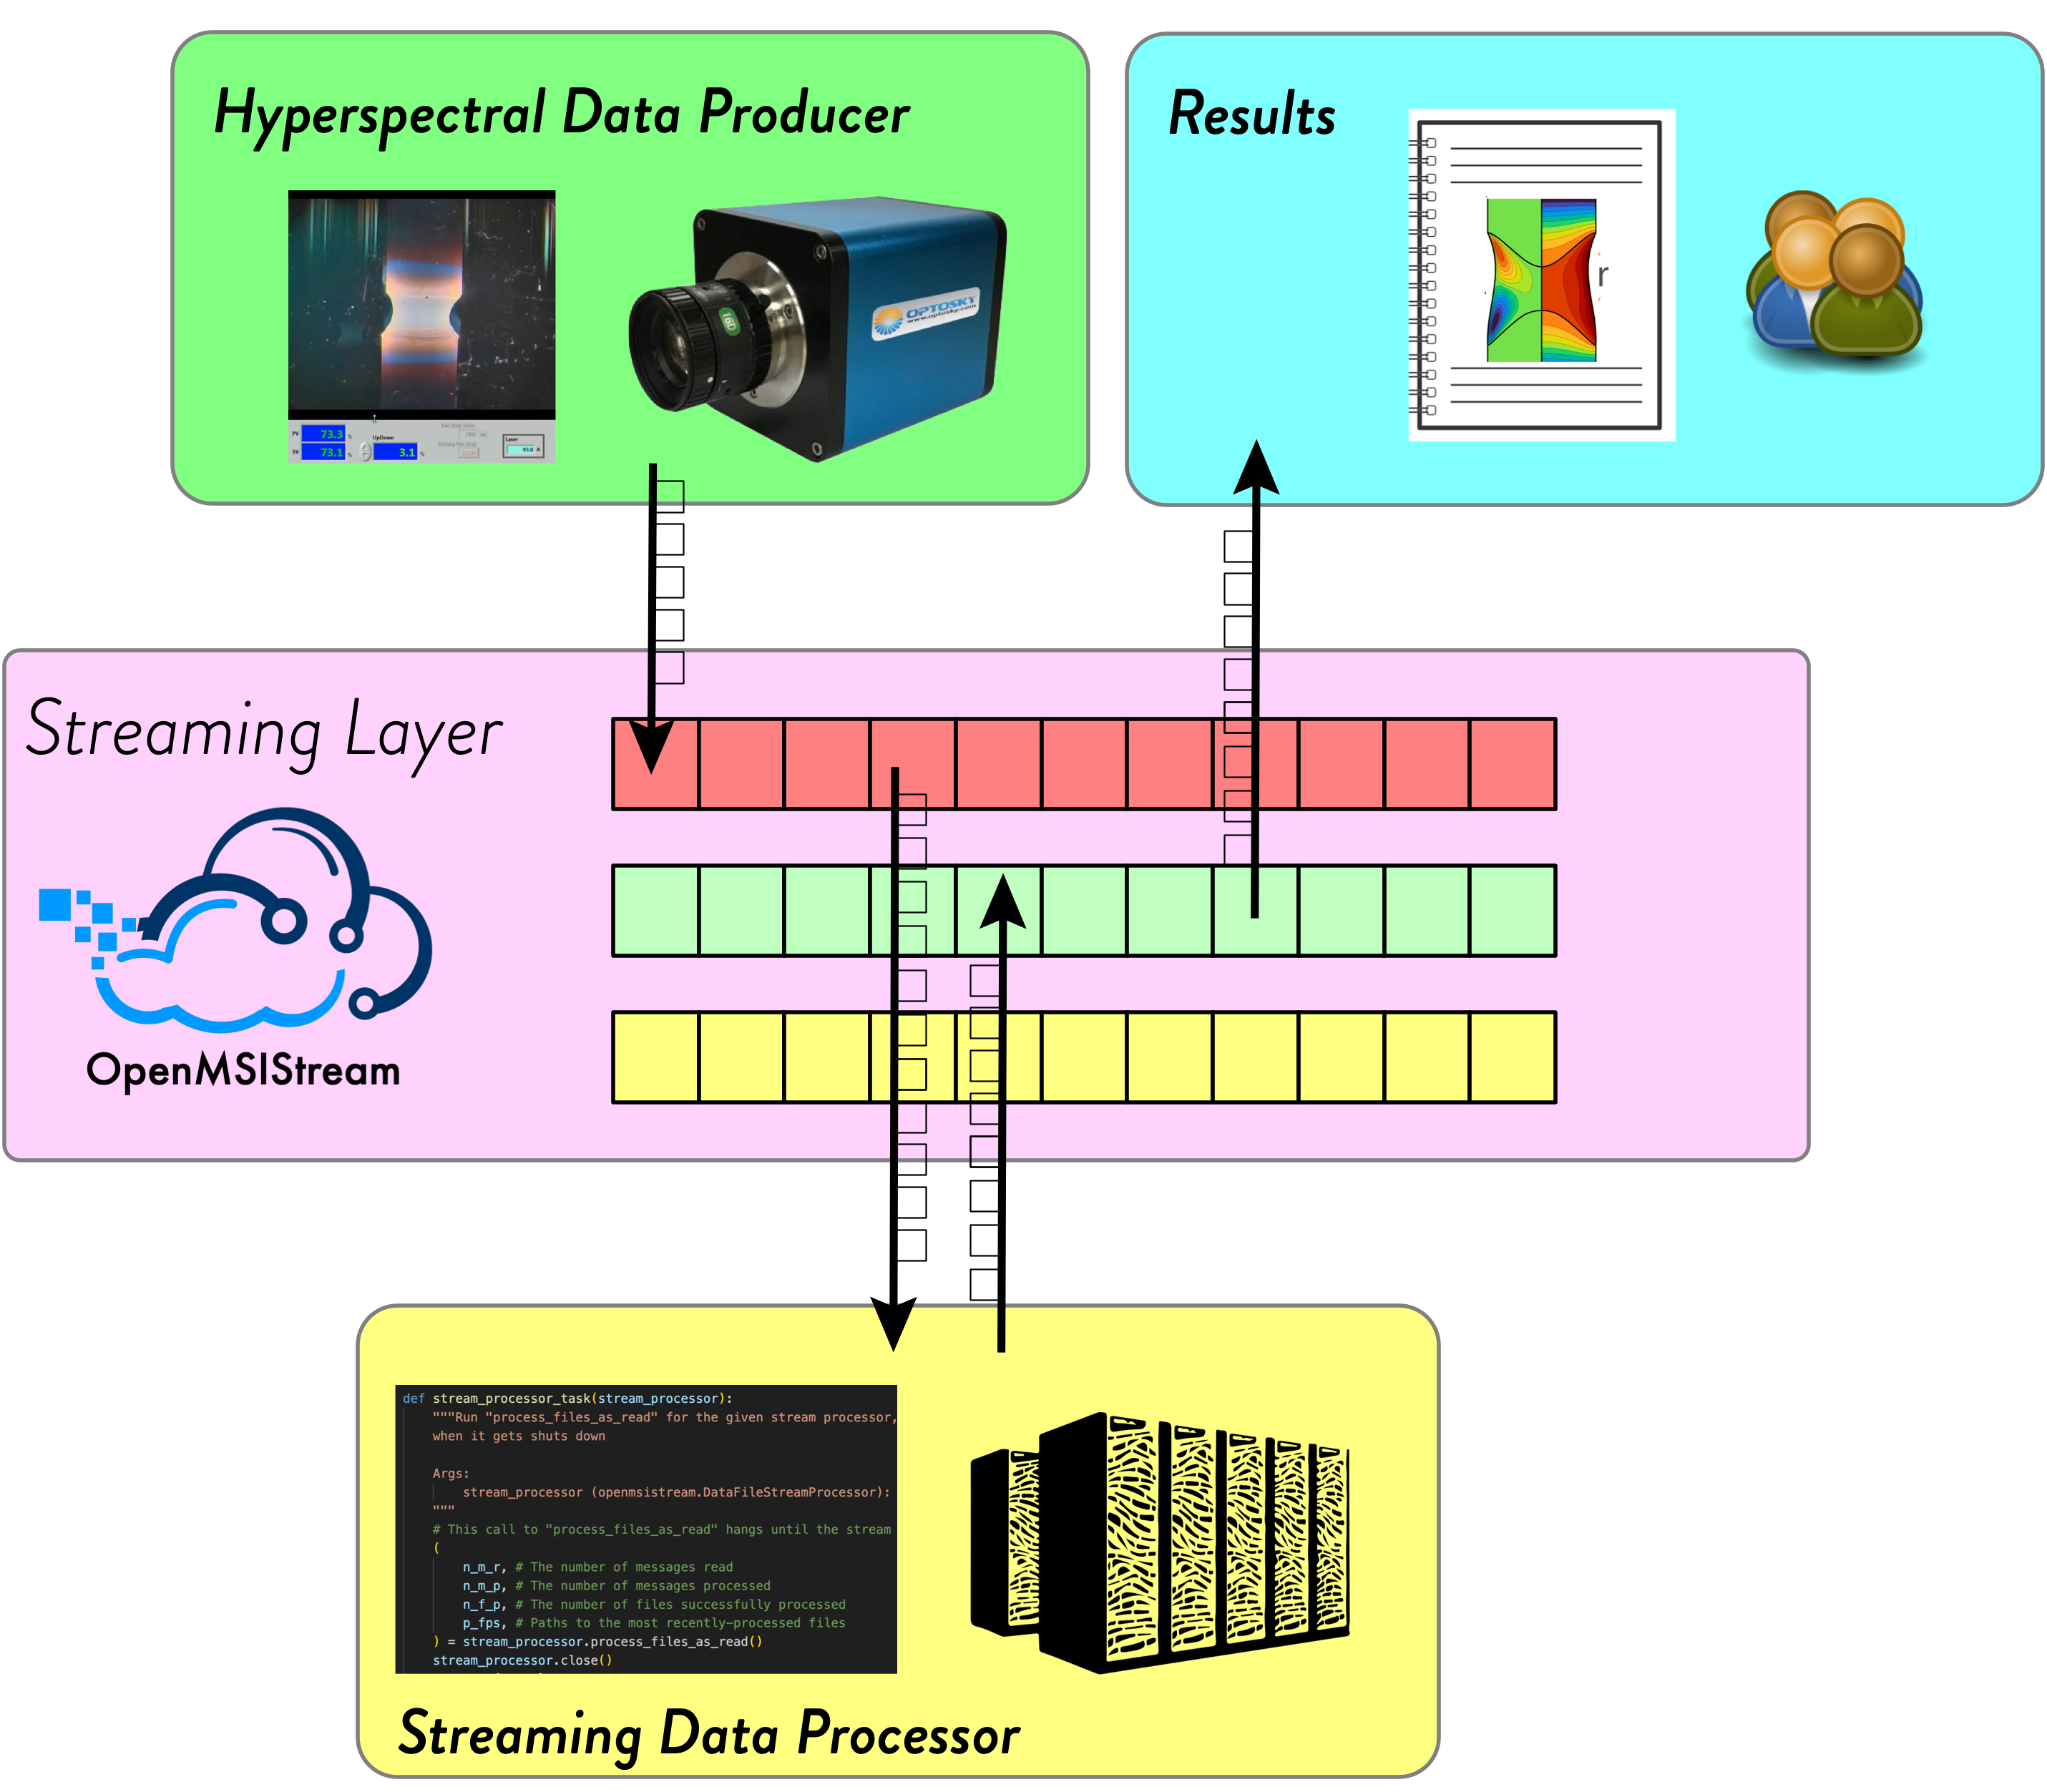
Notes:
This is the software with which we stream data from lab equipment. What is data streaming? When some data is collected, it is automatically streamed from the machine where it was collected and can be received (or consumed) by any other machine. For our use, this includes data storage servers and servers on which the data is analyzed. The result of the analysis is then also stored and streamed back to the machine where it was collected for the experimenter to see

Slide 15
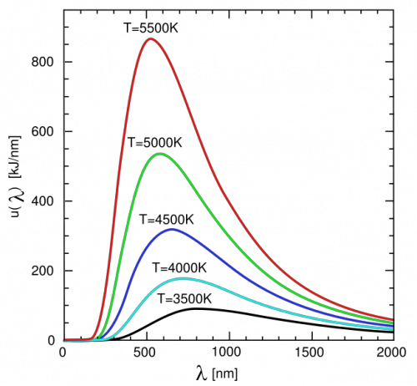
Analysis
Blackbody
Notes:
The great thing about blackbodies is that their emission spectra are very dependent on their temperature. So, the spectrum at each pixel in a hyperspectral image, when interpreted as blackbody radiation, contains the necessary information to determine its temperature

Slide 16
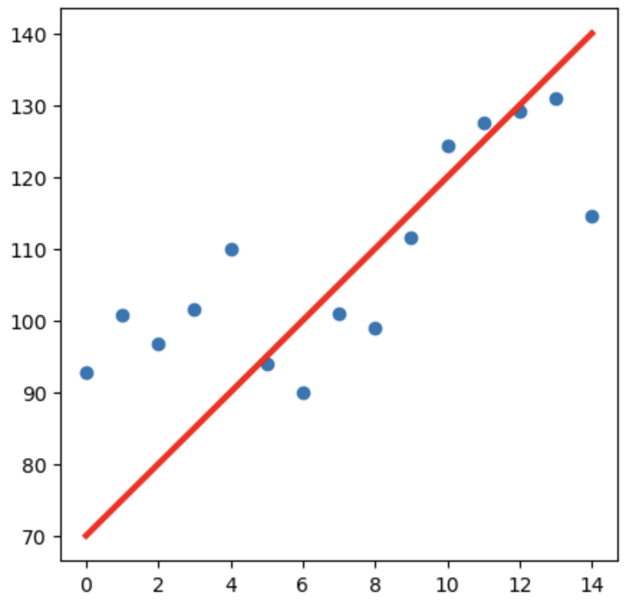
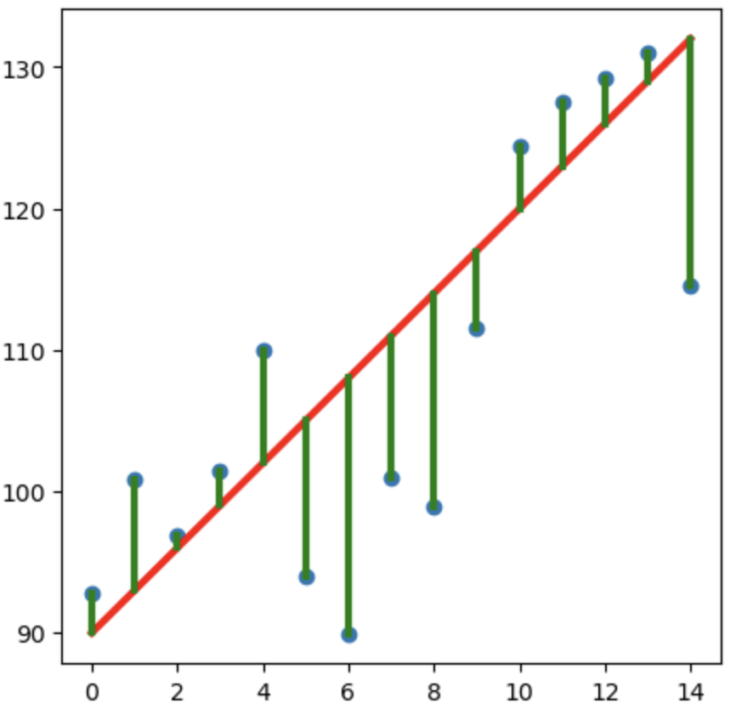
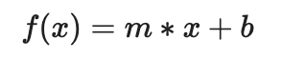
Least Squares Regression
Model Function
Guess Parameters
Minimize Residuals
Parameters
Notes:
The way to fit data to som

Slide 17
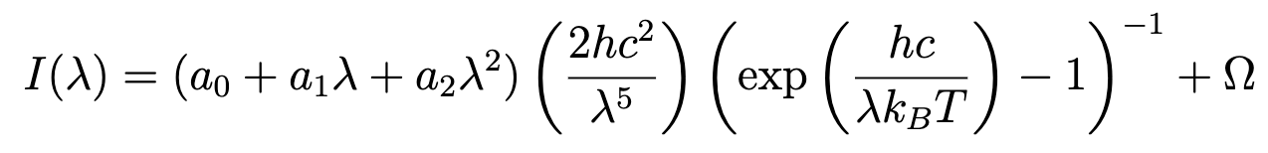
Blackbody Model Function
Emissivity
Stray Light Offset
Parameters
Notes:
Notice that everything that isn’t a parameter is either a constant or the independent variable wavelength

Slide 18
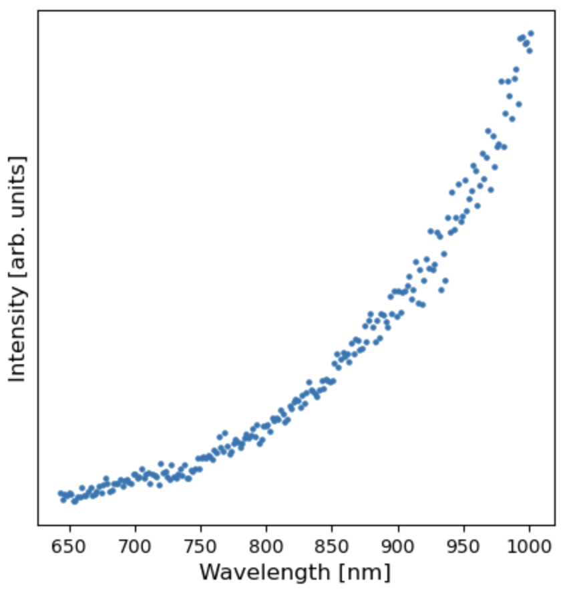
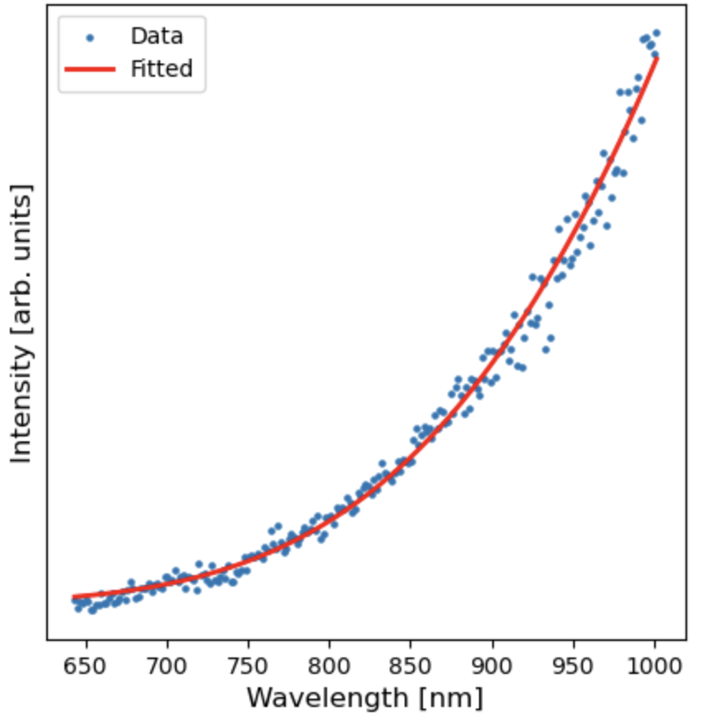
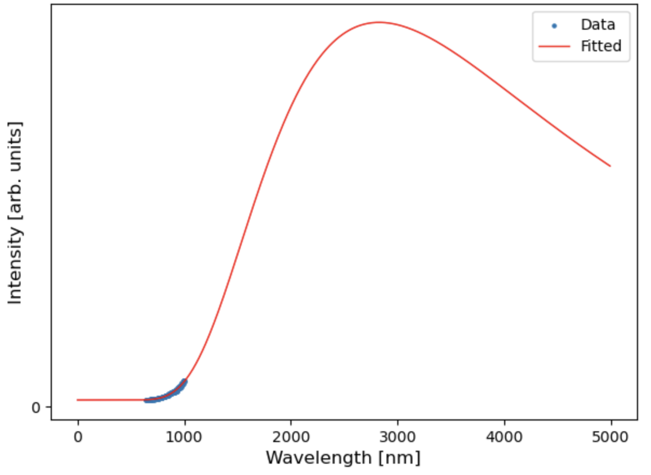
Run the Regression
Data
Fitted with T=1298 K
Full Spectrum

Slide 19
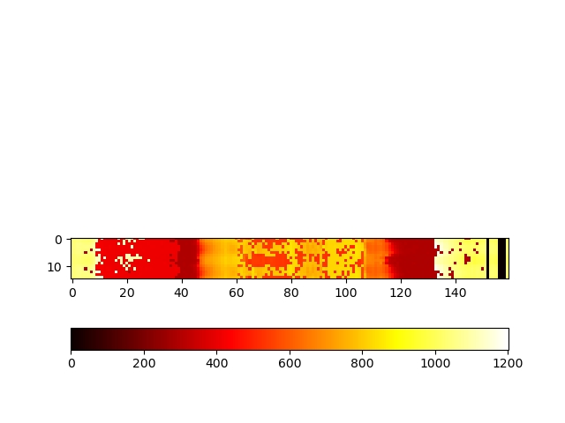
Into the furnace
Kelvin
19

Slide 20
What’s next?
Optimizing the analysis
Collect tons of data
Validate and inform models
Notes:
Optimizations include performance improvement and potentially needing to reduce sensitivity to atomic emission spikes

Slide 21
Physical
Digital
Autonomous Experimentation
Data

Slide 22
Acknowledgements
Evan Crites (McQueen Lab, PARADIM)
Maggie Eminizer (IDIES)
NSF Awards #2039380 (PARADIM) and #2129051 (VariMat)
Kelvin

Slide 23
Extra Slides – Camera Motion

Slide 24
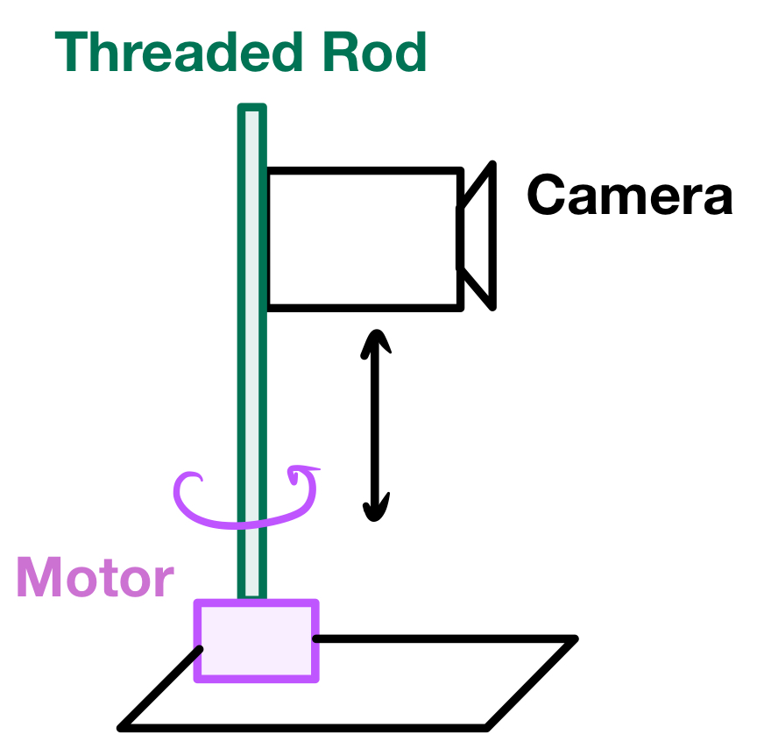
Notes:
How do we make it scan?

Slide 25
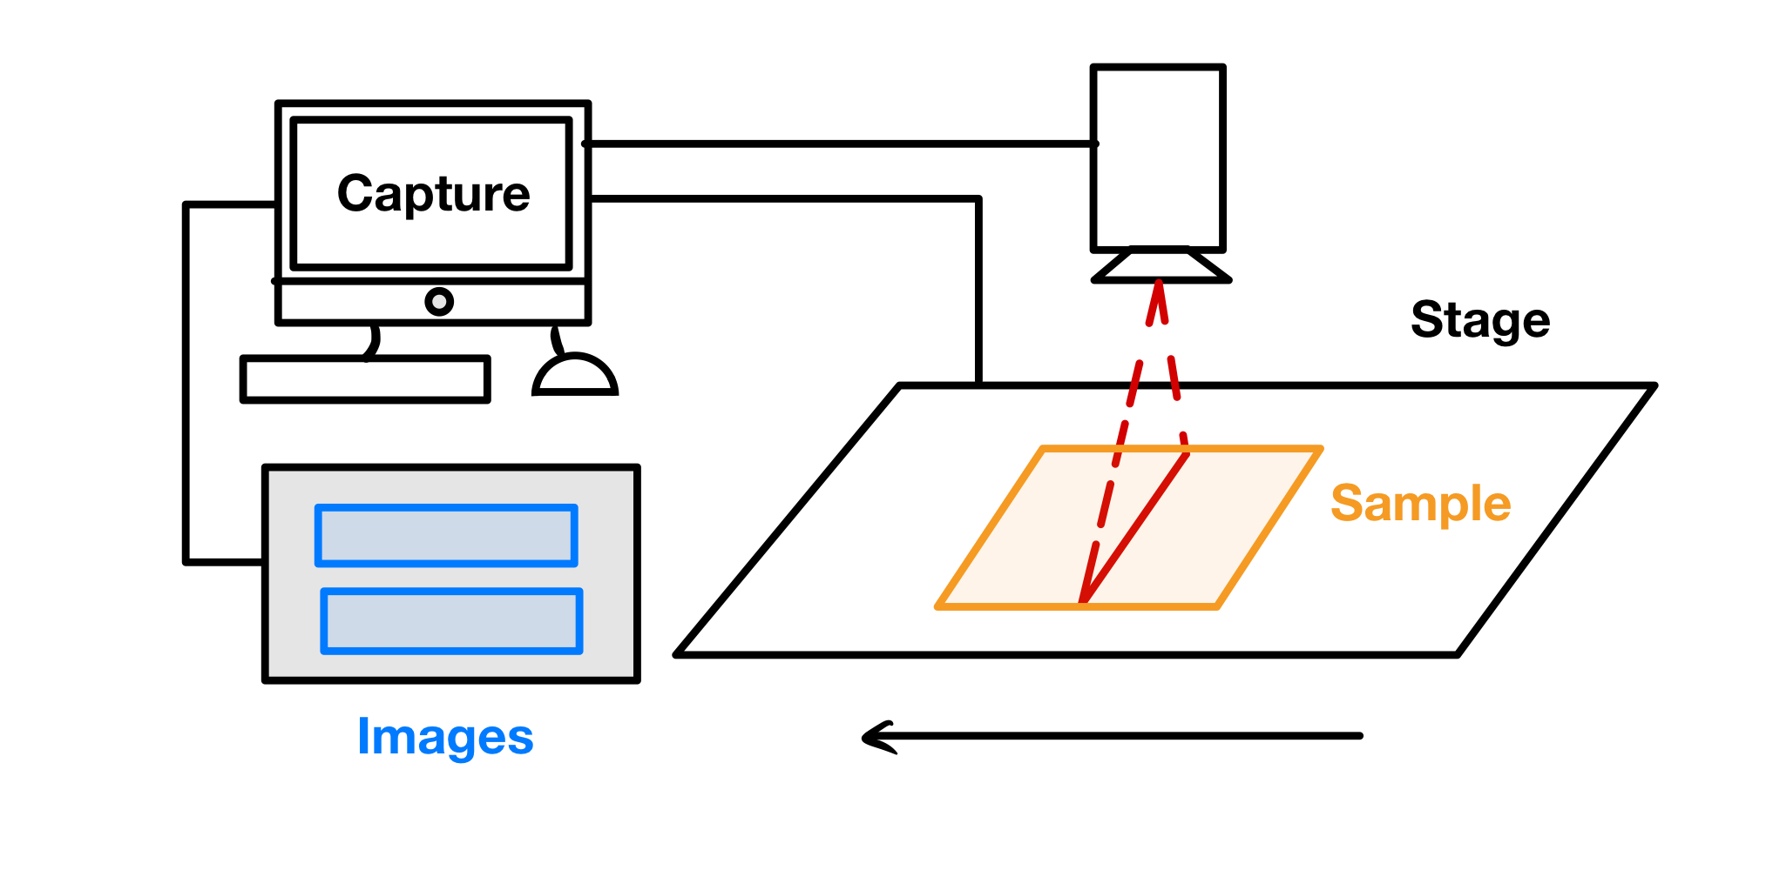
Notes:
Why does it need to move?
Important to note that the computer syncs the start of the image capture and the movement of the stage

Slide 26
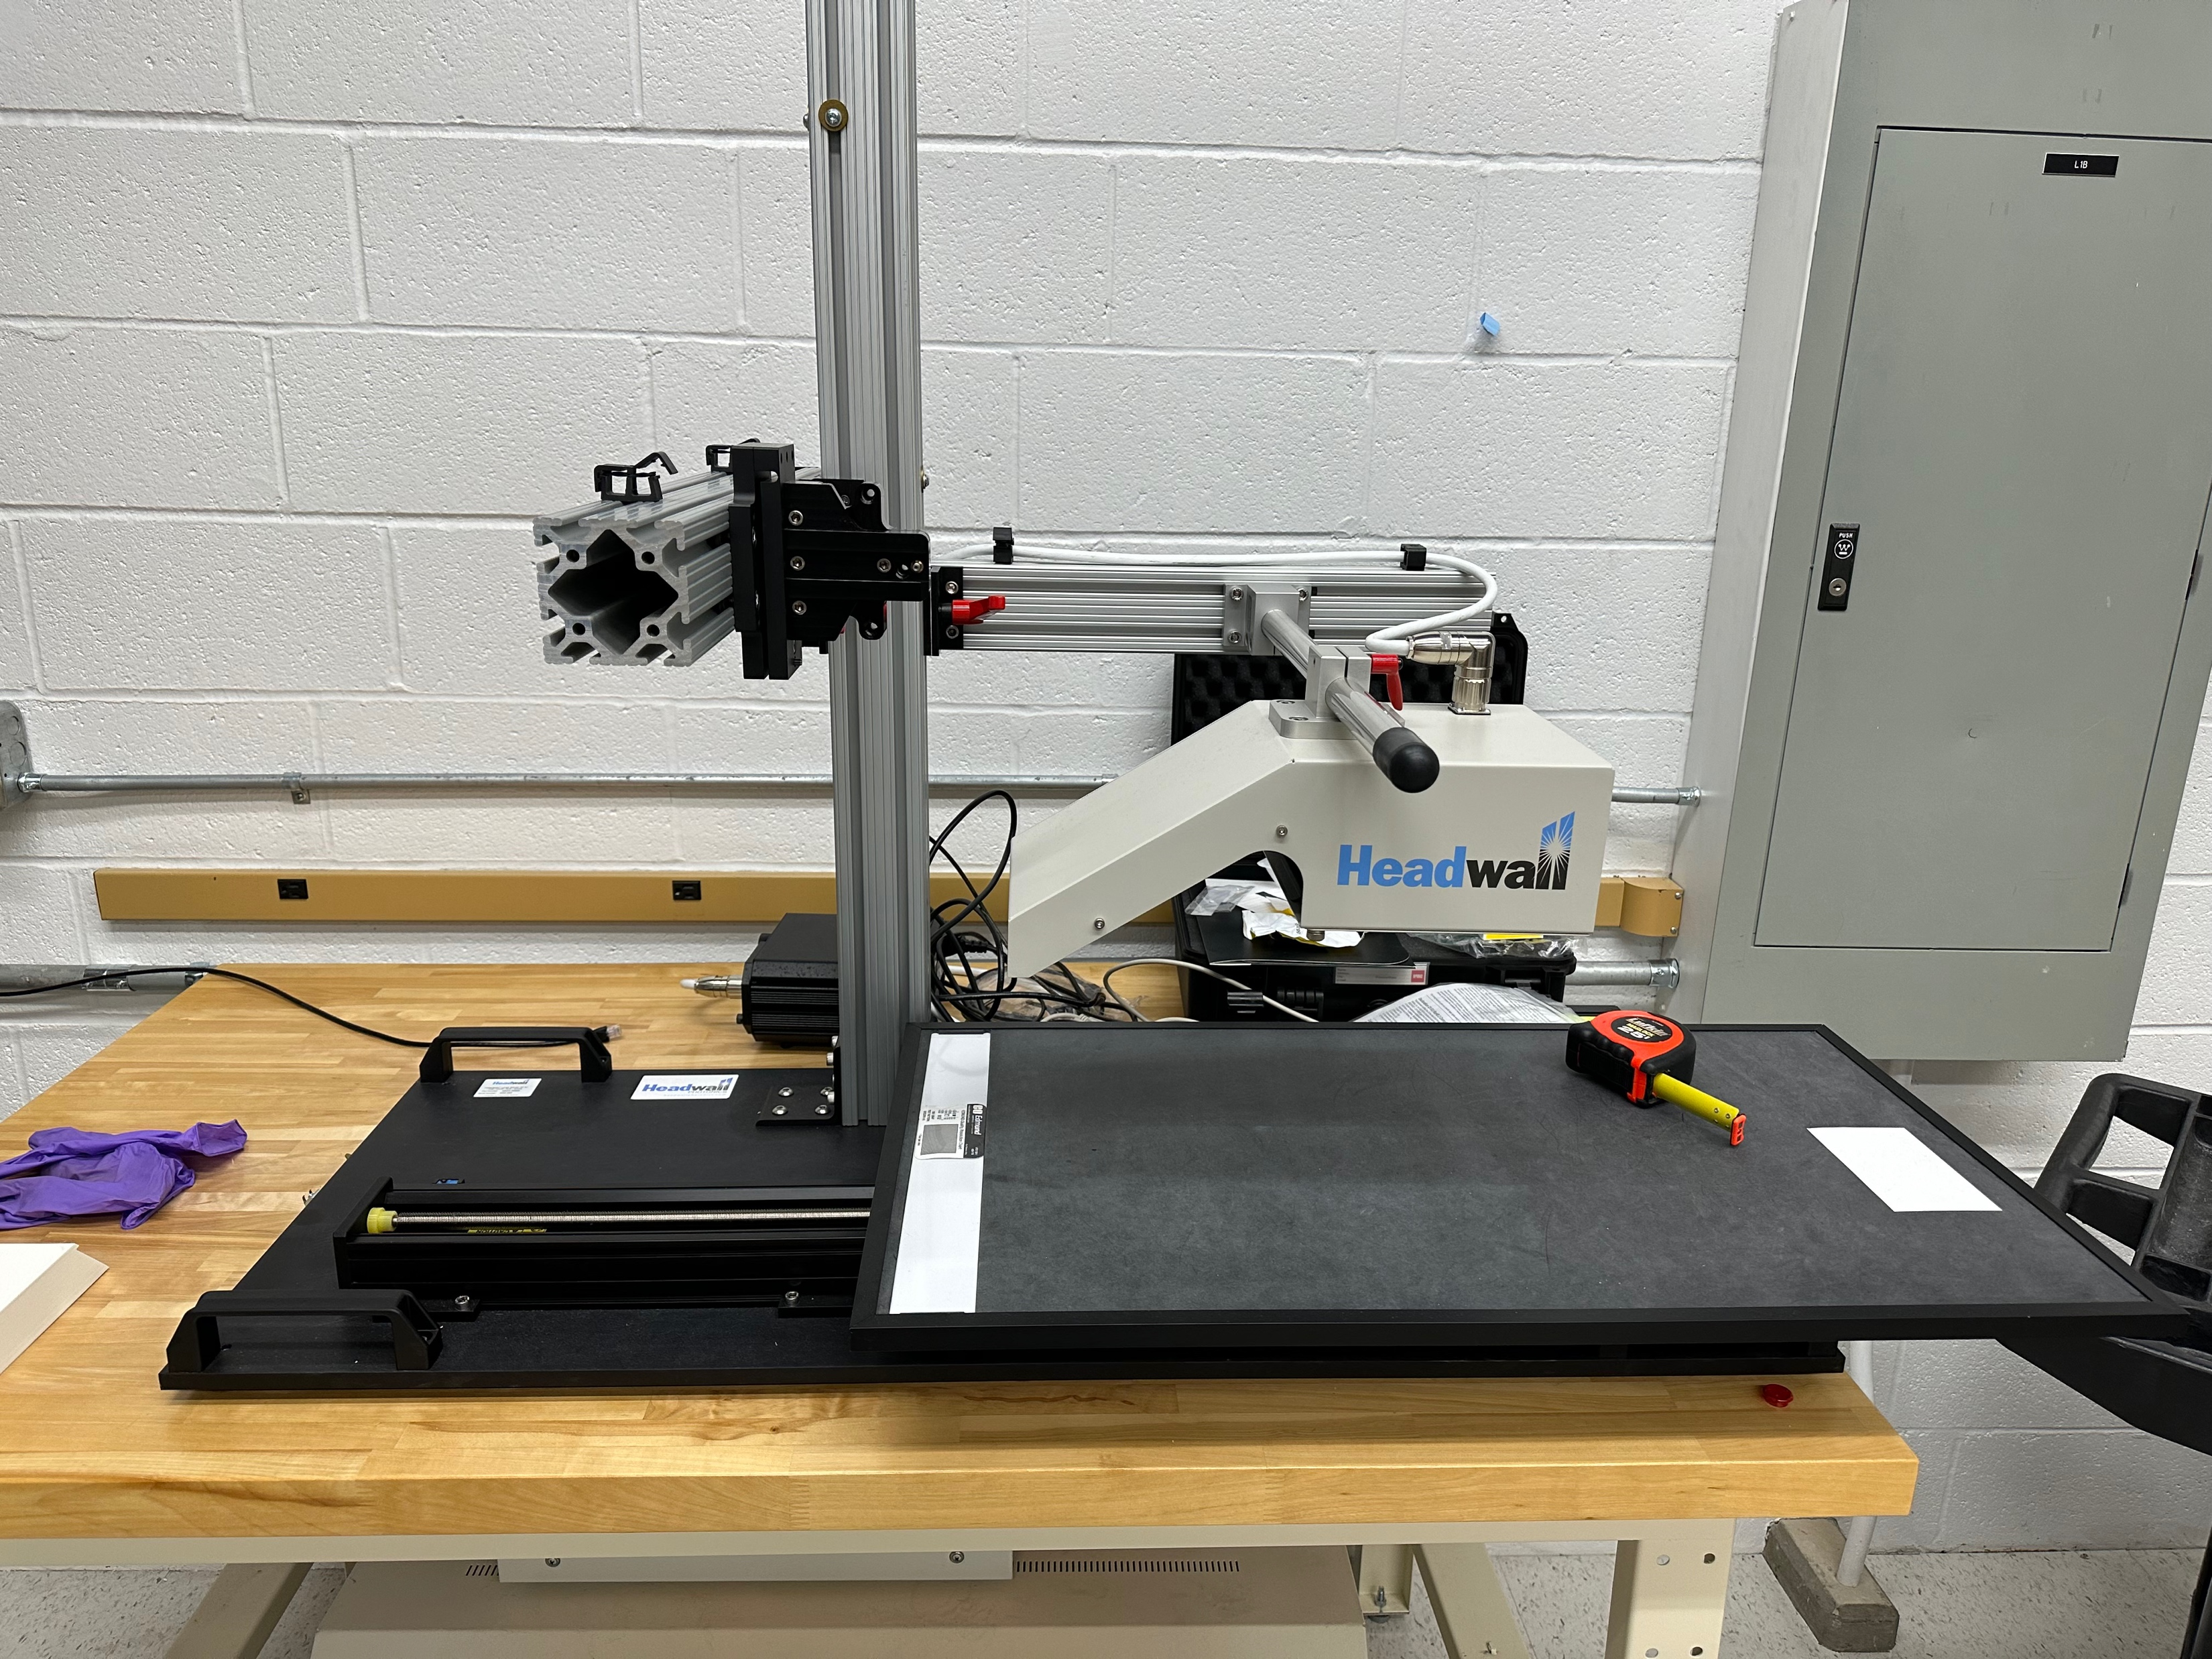

Slide 27
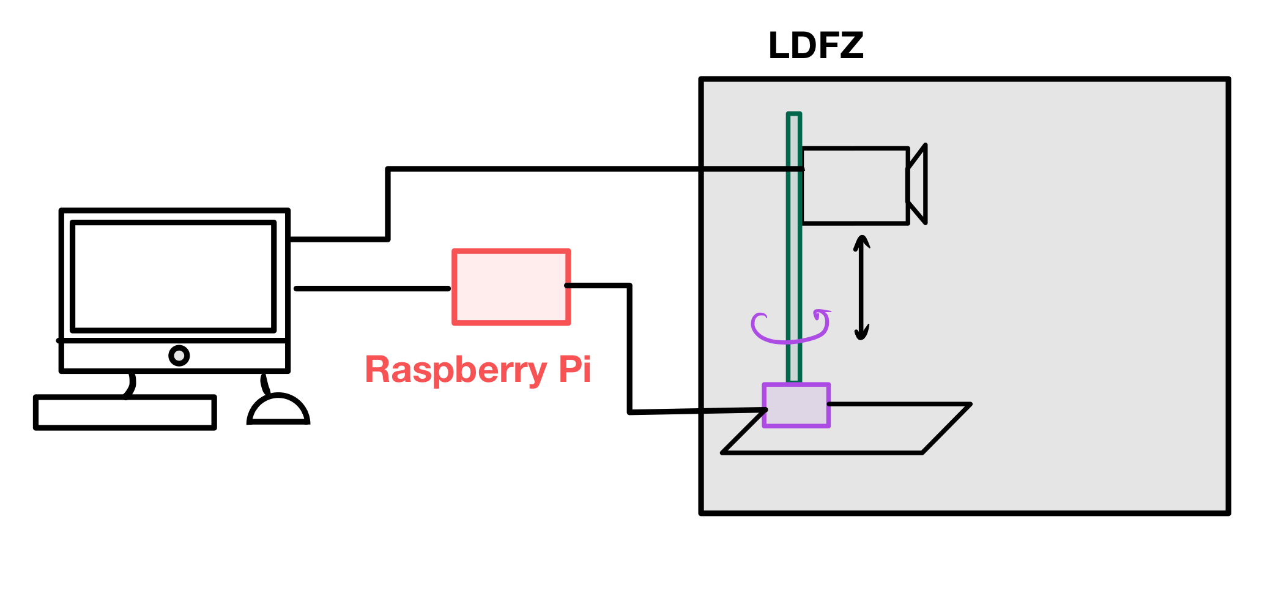
Notes:
How do we sync the motor with the image capture? We are replacing the stage with the motor

Slide 28
Extra Slides – Streaming

Slide 29
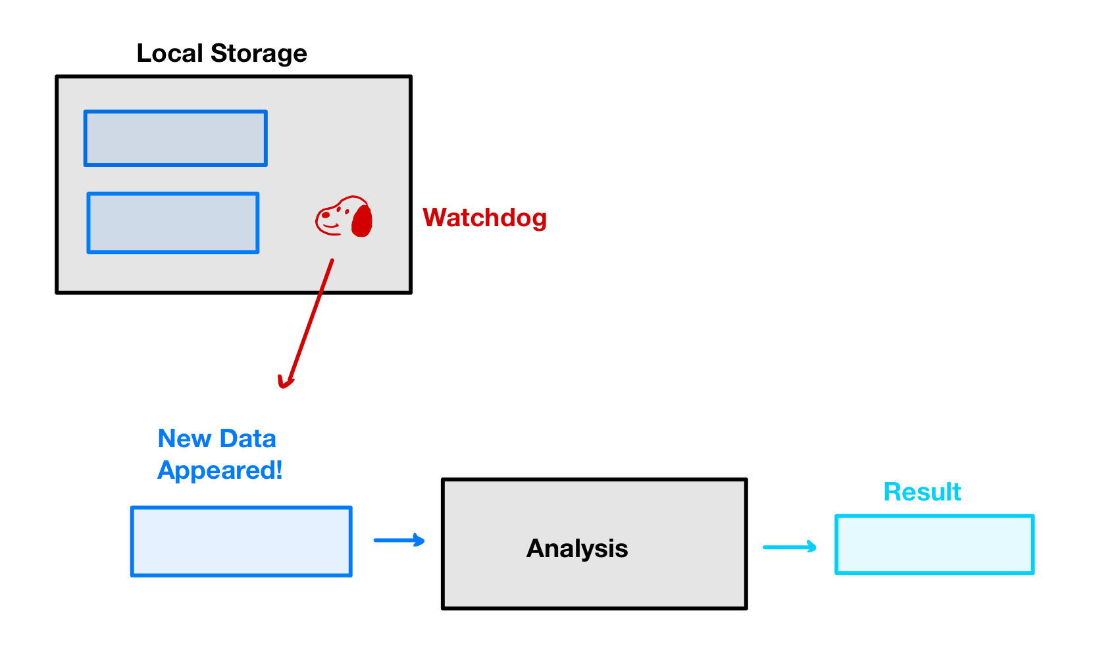

Slide 30
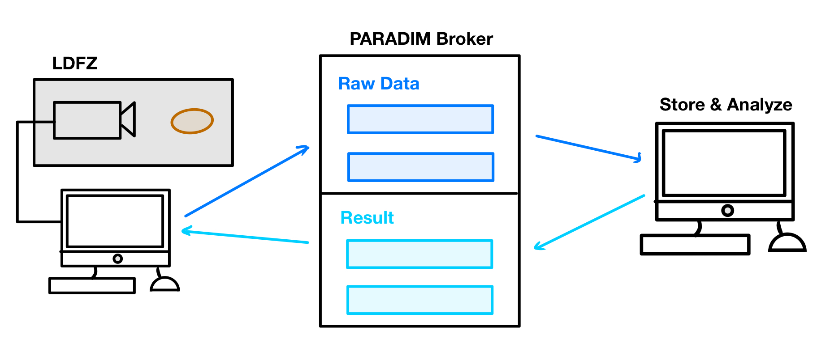
Notes:
Animate in one piece at a time

Slide 31
